Slide 1
Project Feedback

Slide 2
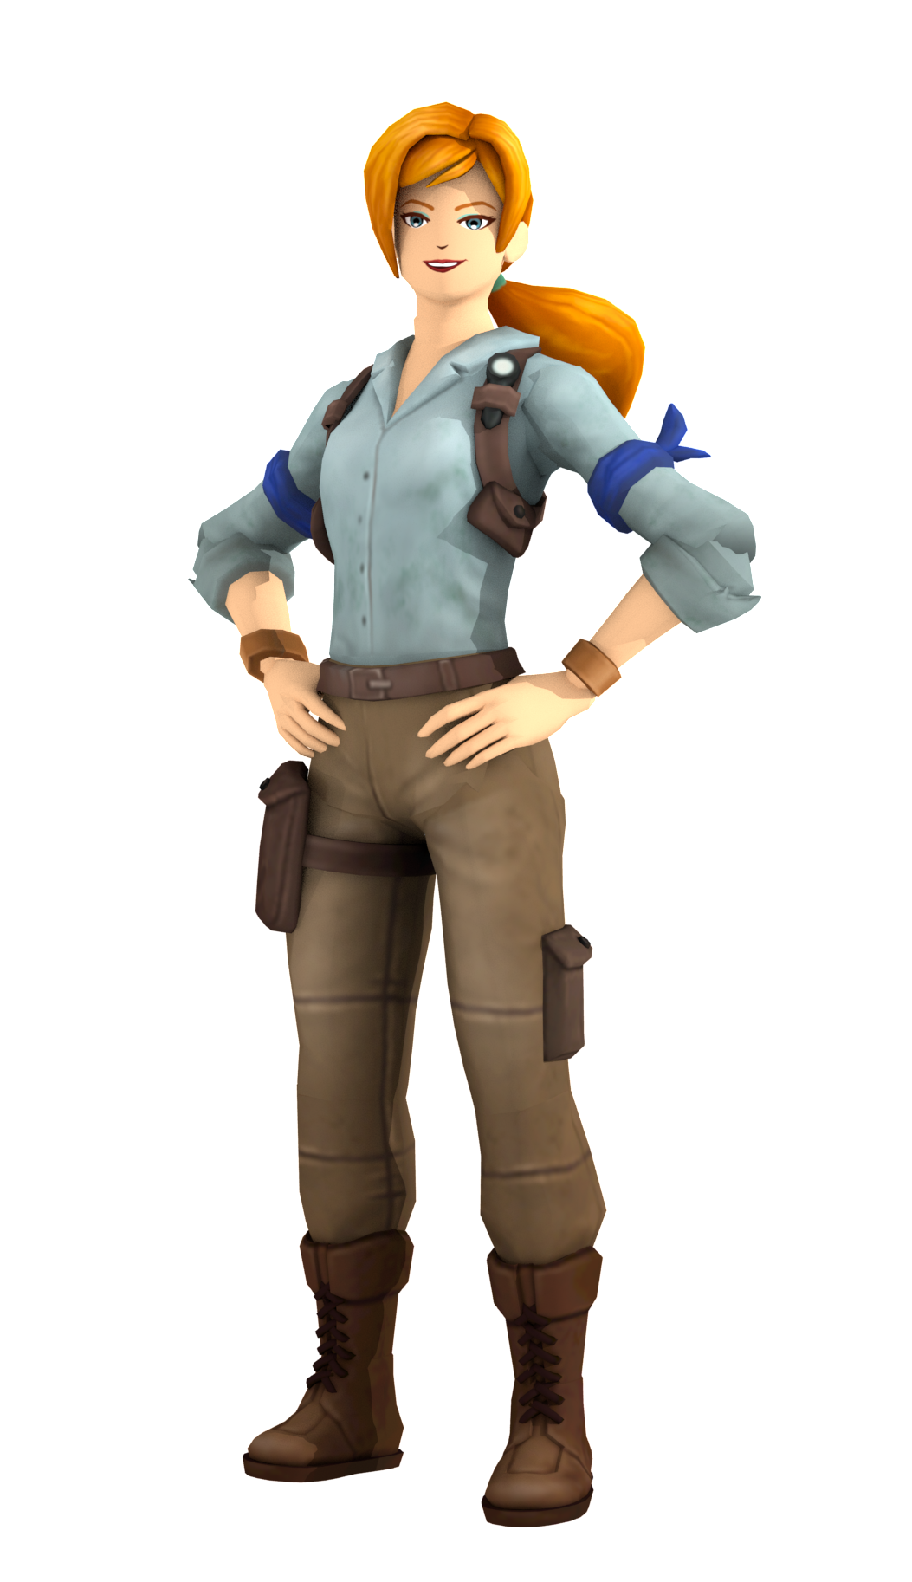
2 Stars and a Wish
Guidelines
Play someone else's game. Then, tell them something you liked, and something you wish they improved or changed.
Show Respect - Don't change someone's game without permission.
Understand - People have different things they like. Evaluate based on your goals.
Assume Good Intentions - Everyone wants to help and can be helped.

Slide 3
Writing Feedback For Others
Make your feedback specific.
Use "I" phrases, never "you".
Avoid negative phrases (ex: bad, boring).
Clear and Helpful | Needs Improvement
The jump between the first two blocks was hard. It took me five tries. | The game was too hard. You made something isn't fun.
The game didn't have much variety in how it looked. Parts looked the same. | The game's boring to look at.

Slide 4
Play Someone Else's Game

Slide 5
Write Feedback on Handout

Slide 6
Reflect on Your Feedback
"The tester said that the jumps were too hard."
"The jumps between the green and blue blocks were too easy"
Determine Your Next Step
"I'll make the blocks bigger so the jumps aren't that hard".
"I'm going to make the jumps between the green and blue blocks longer so it's harder, but fun."

