Slide 1
Intro to Digital Safety

Slide 2
Staying Safe Online
General Information Okay to share | Personal Identifying Information Don't share
How you earned an avatar item. Tips for getting better at a game. What you like about a game. | Name, age, gender identity, where you live. Contact or social media information (Emails, social media usernames, etc). Roblox Account information (passwords).

Slide 3

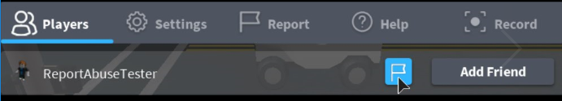
Making a Report
If someone online is being abusive, or you were the victim of a scam, file a report.
In Roblox, click the Menu button
Find that specific player. Click the Report button.

Slide 4
Writing Good Reports
So reports can be helpful, make sure they are clear and specific
"A player is being mean. Help!" | Not Specific - doesn't provide specific information people can use to take action.
"Snarly is messaging people about giving out free robux if they go to this website." | Specific and Clear - Mentions a specific user and what they were doing.

Slide 5
Spotting Unreliable Information
These four clues can help:
Clue 1: Transactions that deal with real life money or gifts like free Robux.
Clue 2: Prompts you for account or private information.
Clue 3: Makes claims without a source
Clue 4: Uses links to non-Roblox websites.

Slide 6
Spotting Unreliable Information
Why can you trust one and not the other?
Reliable | Unreliable
If you buy a game pass in this game's shop, you can make your pet fly! | Go to robloxhacks.com to learn how to make your pet fly for free!

Slide 7
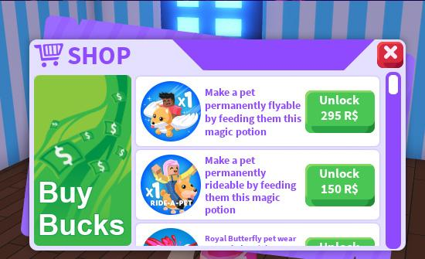
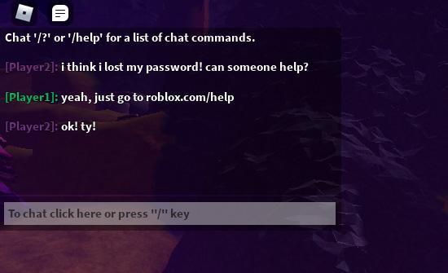
Reliable Information In-Game
Why can you trust these examples?
Screenshot from Adopt Me!
Notes:
The Adopt Me uses Robux, it tells you exactly what you're getting, and is clear on what you're getting.
Player1 mentions a real website that isn't fake. They're not asking for any account information.

Slide 8
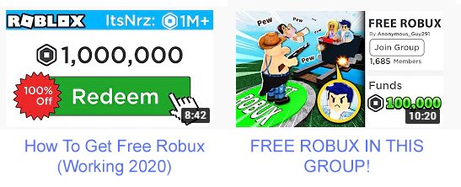
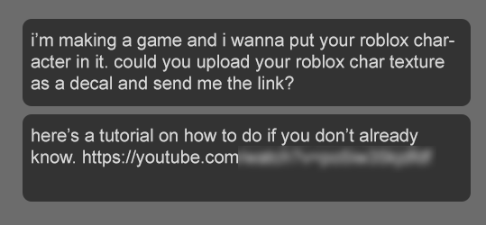
Unreliable Information
Why can't you trust these?
The above real life scam would take people to Youtube. They'd then follow instructions to type in something into their browser, which had malicious code, causing them to lose their accounts.
Notes:
The Adopt Me uses Robux, it tells you exactly what you're getting, and is clear on what you're getting.
Player1 mentions a real website that isn't fake. They're not asking for any account information.

