Slide 1
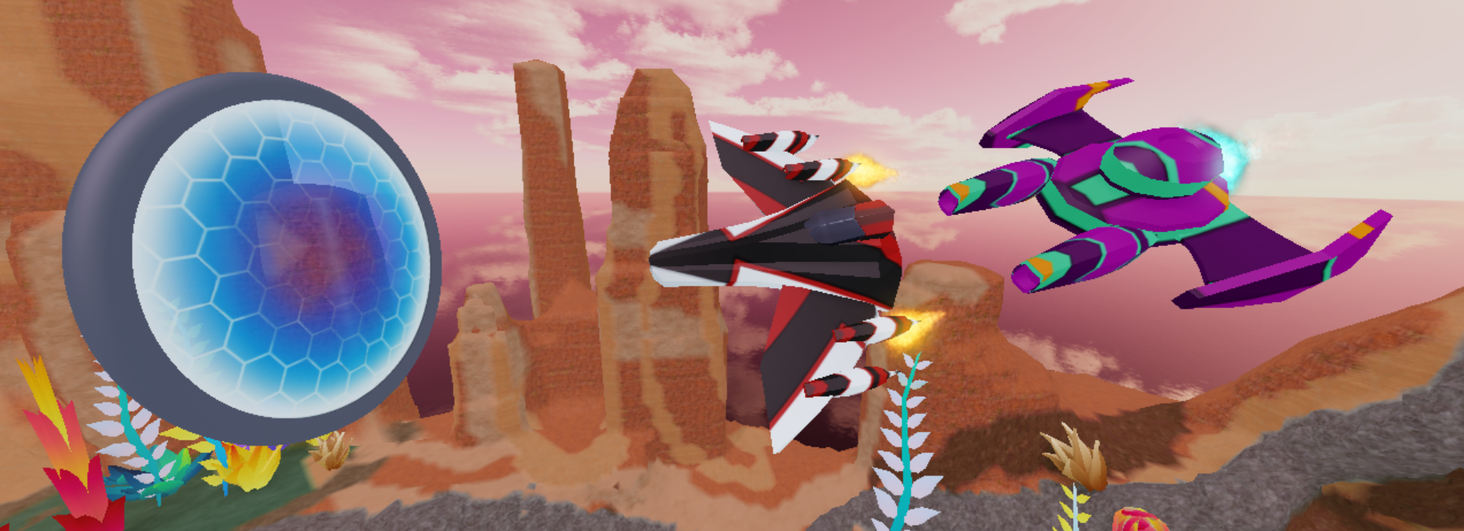



Slide 2
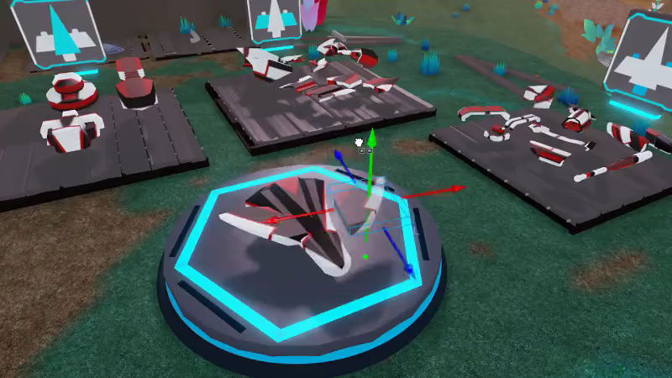

Slide 3
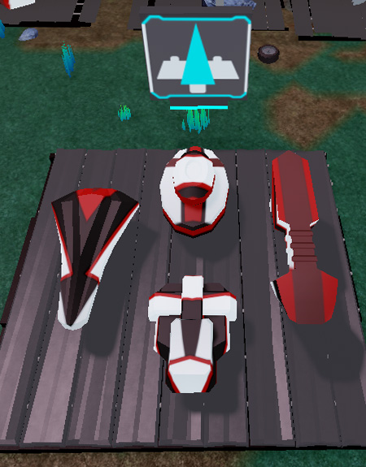
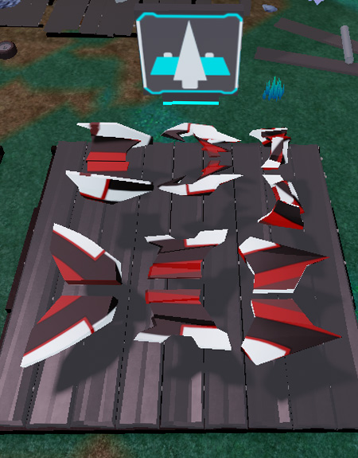
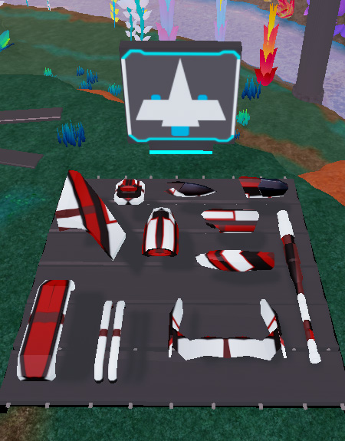
Build in 3 Steps
Pick a Body
Add Wings
Add Decorations

Slide 4
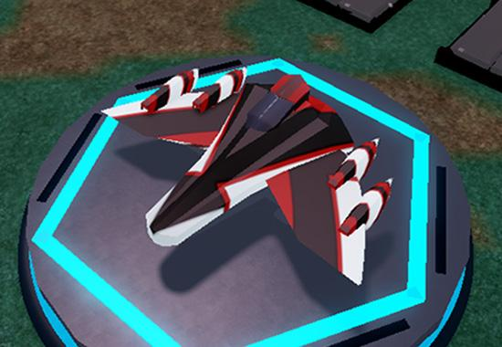
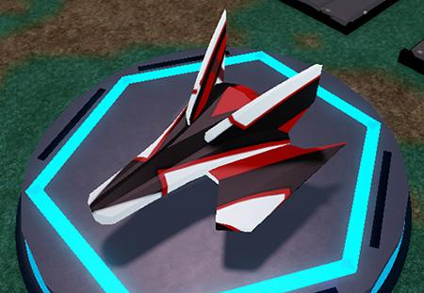
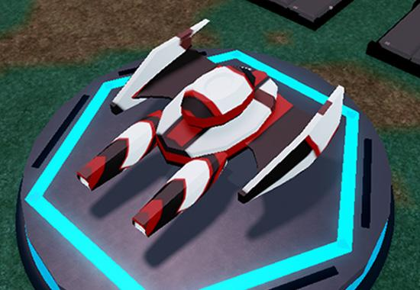
Inspiration Speeders

Slide 5
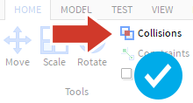
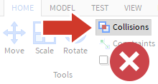
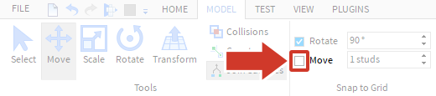
Get Ready to Build
Turn Off Collisions
Turn Off Move Snapping

Slide 6





Studio Cheatsheet
Camera Controls (Studio)
Tools
Move | W A S D Keyboard Keys
Rotate | Hold the right mouse button and look around
Zoom | Use the scroll wheel
Focus | Press F to focus the camera on a specific part
Move parts
Scale or resize parts
Rotate parts
Playtest to run a game.
Stop a playtest.

Slide 7
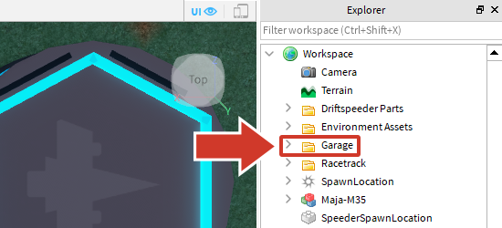
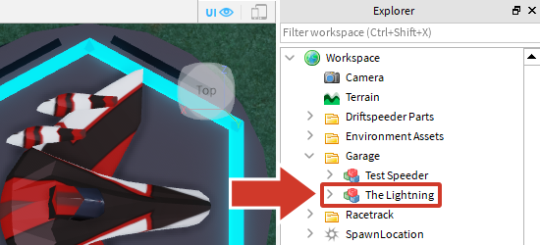
Add to the Garage
Do this step when finished with your speeder
Find Garage Folder
Paste Into And Rename

